Slide 1
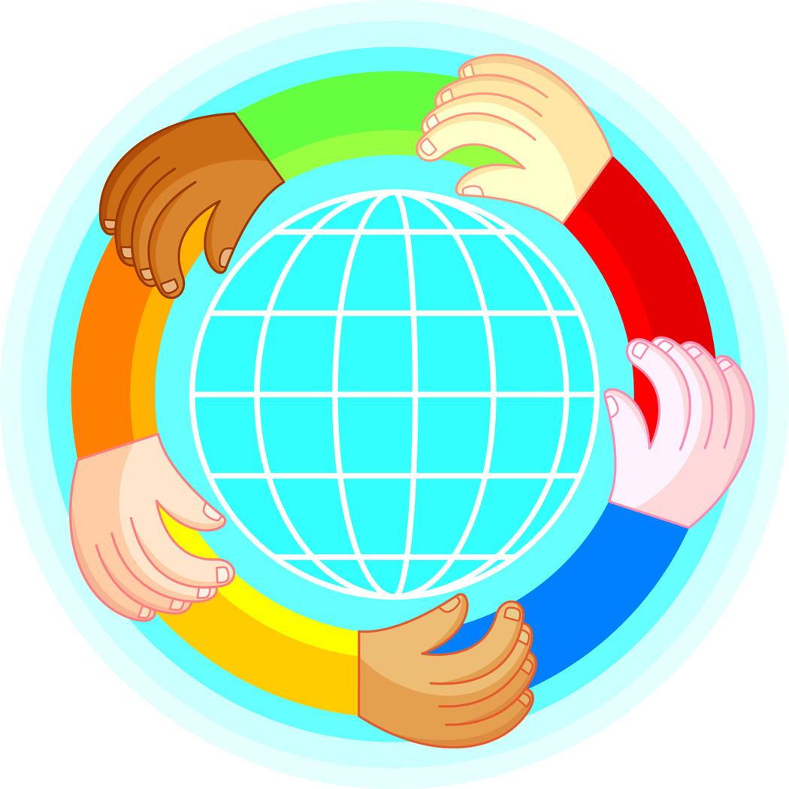
Through the eyes of children
Our Changing World: A Global Perspective
Shannon Russell

Slide 2
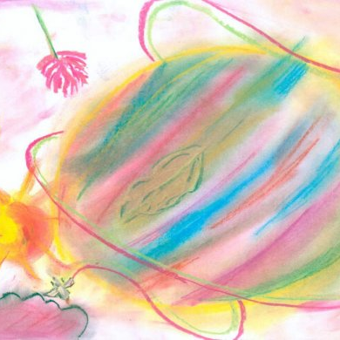
Pluralism in Pastels
This child views the world and its citizens as interwoven, blended, and united. Though all the different components come together beautifully, it is still possible to see the different colors and elements that comprise it. They are lovely both individually, and as one.
“A World of Colours” – from Norway

Slide 3
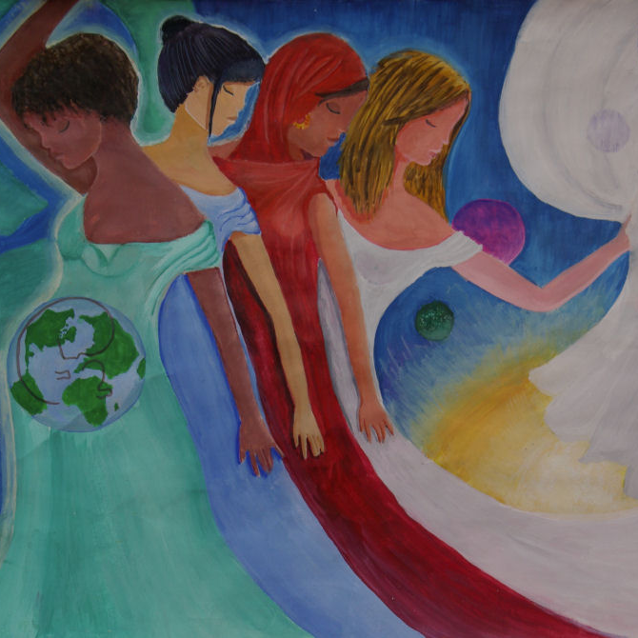
Mother of Earth
To this child, our world is one part of something much larger. The pregnant woman, or our place in the universe, is warm, beautiful, safe, and nurturing. This “womb” holds us together and keeps us safely bound to one another.
“Our Life is Eternal” - Ukraine

Slide 4
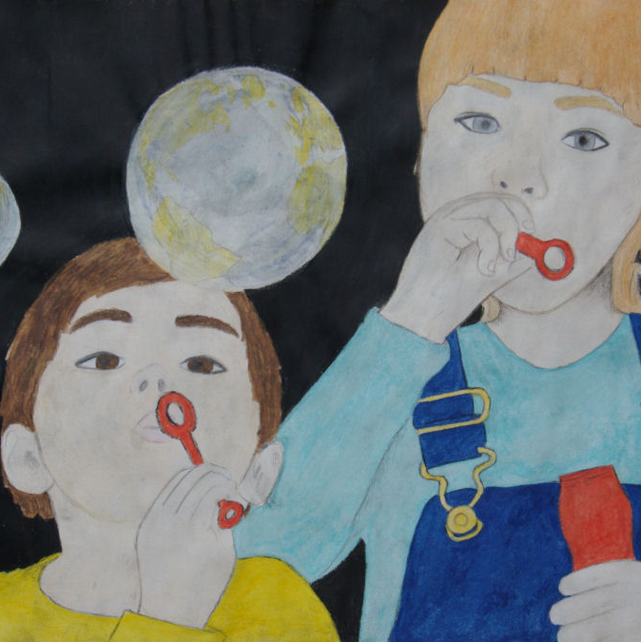
Our Shrinking World
This child ‘s picture acknowledges the reality that the world is becoming “smaller”, due to technology that makes communication fast and easy, efficient means of travel, and an increasingly globalized world society. This child is able to see the entire world in one small bubble; something children of generations hundreds of years ago would probably not have envisioned.
“Our United World” - Finland

Slide 5
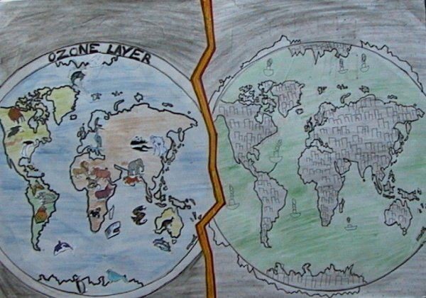
Our Future?
“Crystal Ball” – New Zealand
The child’s desire for a clean, safe, habitable, colorful world in the first picture juxtaposed next to a desolate, dead, dark world in the second makes evident his concern for our planet’s future. This child wants people to take care of our world, lest it be destroyed and make his fear a reality.

Slide 6
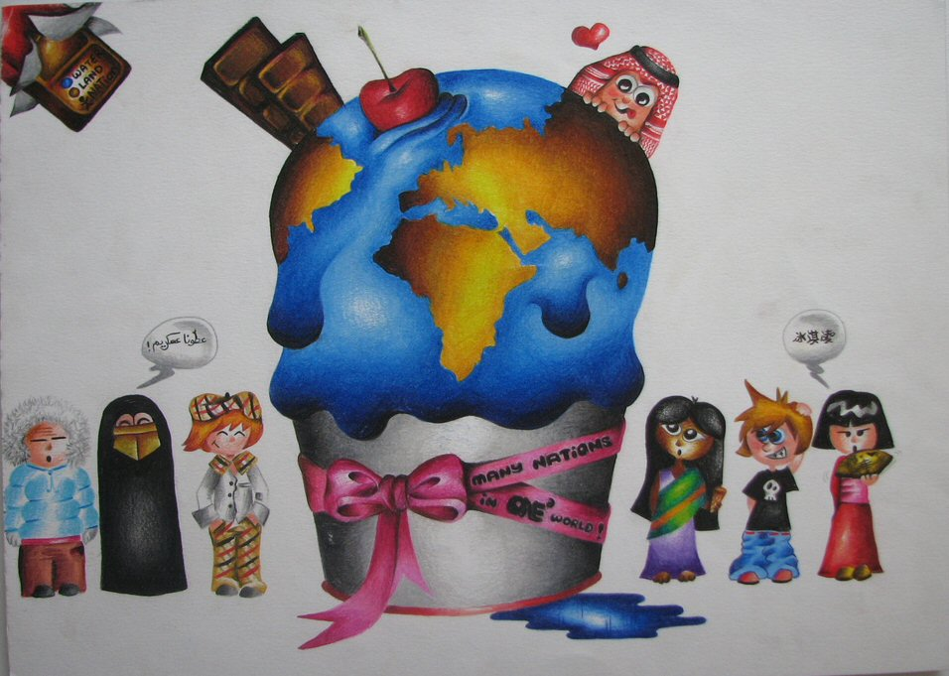
Our World…A Treat for All!!
“Untitled” - Qatar
This child views the world as a gift, as is evident by the bow and writing on it, for all different types of people to share and enjoy. This child may have some concern about the state of environment; the melting ice cream may represent global warming.

Slide 7
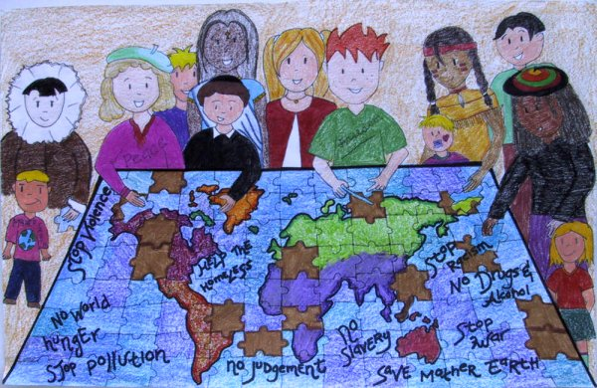
This picture is a humanistic, harmonious, and hopeful representation of our world. This child’s work conveys the idea that though people are diverse, they can still make choices to promote unity and the well-being of all. In a sense, this picture is a representation of a global family; many pieces of the puzzle (diverse people) come together to make a complete society.
Jigsaw
“United Pieces” - Canada

Slide 8
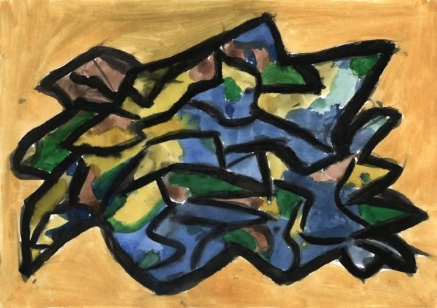
This picture makes evident the child’s perception that the world is connected, melded, and each part of it is in some way part of the rest of the whole. Different regions, people, and areas are dependent on other regions, people, and areas; we are all connected in a global mosaic.
A Collage of Cultures…
“Earth in Kaleidescope” – Czech Republic

Slide 9
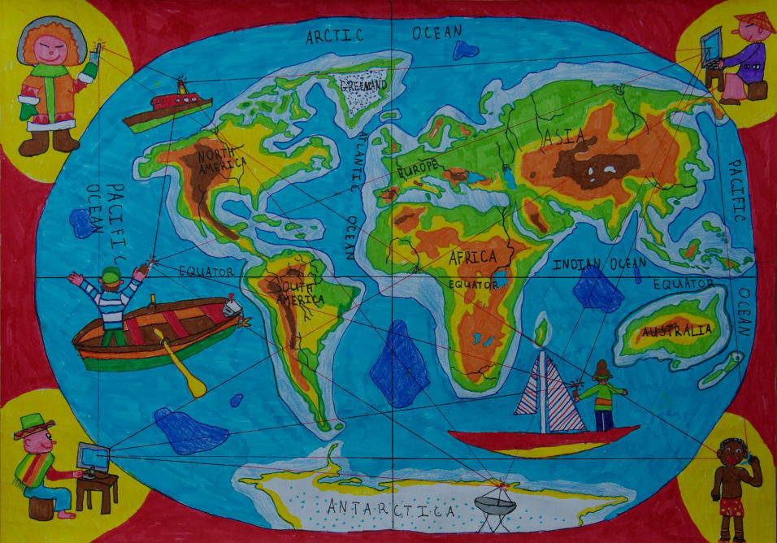
This child has a strong understanding that what happens in one part of the world impacts what happens in other parts. The strings connecting the people and places in the image are so intertwined, that by pulling one string others will be pulled as well. This child realizes that actions in a global society have global consequences. This picture is more deeply analyzed on the next slide.
We are Woven Together
“Let’s Help Each Other Easier” - Bulgaria

Slide 10
A Deeper Analysis…
  In the previous image, the child showed a sophisticated understanding of the interconnectedness of the world. This shows knowledge of social studies, because he understands the global exchange of markets, ideas, and shared responsibility of problems. Because he demonstrates understanding of global involvement, it can be assumed he also understands politics plays a role in how much or little each country chooses to be involved in global issues. He also has knowledge of geography, as is evident by the accurately placed continents and oceans on his map. The diverse images of people (different clothes, doing different things, etc.) makes it clear he understands that people are diverse and are all part of our global society. Because we know that people learn based on prior knowledge, we can assume that this child’s experiences and education (whether at home, school, or both) have kept him globally aware. He must be surrounded by people or curriculum that help give him this global perspective.

Slide 11
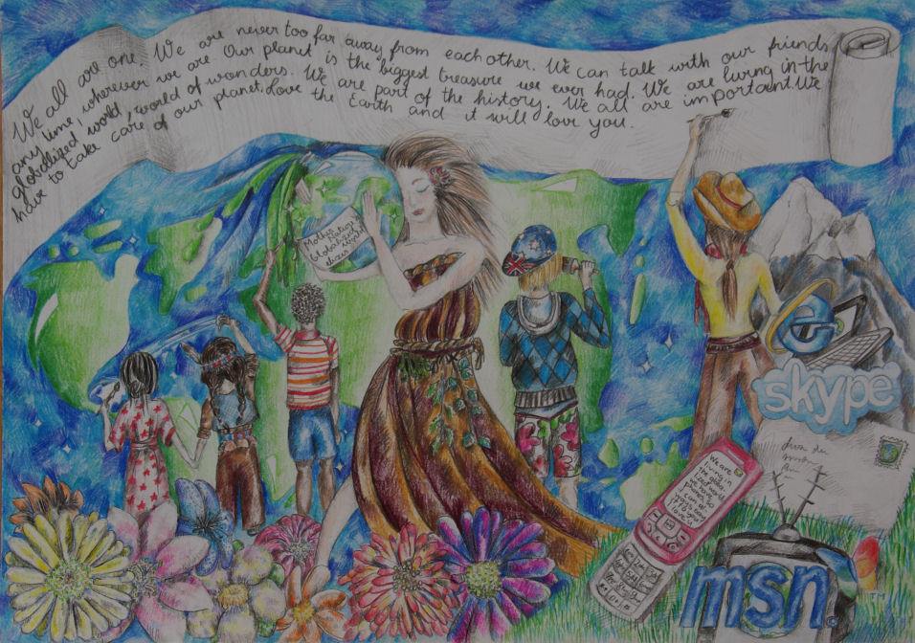
By embedding images representing technology in this picture, this child shows a clear understanding of the fact that it has played a major role in speeding up globalization and making it more efficient. The text on the banner also makes evident the child’s belief that unity, peace, love, and harmony are necessary for a modern world’s success.
Globalization and Technology
“All together, we are building a globalized world” - Estonia

Slide 12
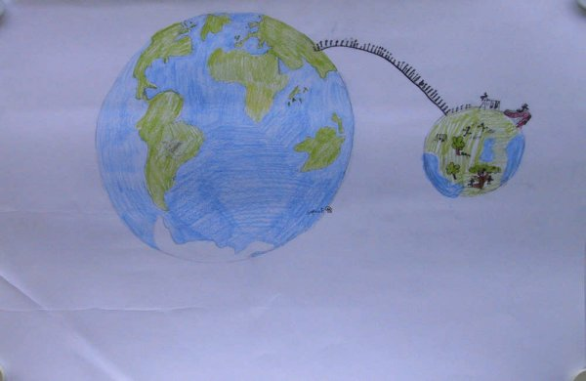
It’s a Smaller World, After All…
“Untitled” - Sweden
This child recognizes that the modern world is changing. By depicting people moving from a larger world to a smaller one, the child demonstrates understanding that technology, travel, and other factors have made it easier than ever to learn about, explore, and be connected to many parts of the world rather than just her own.

Slide 13
Overall Synthesis
All ten of these pictures were created by children who clearly have some degree of global awareness. Through some environment, person(s), or combination of the two, they have acquired prior knowledge enabling them to contextualize global understanding to some degree. The children who created these images seem to desire global interaction, exchange, cooperation, and equality; pluralism abounds in them. Much research shows that it is difficult to instill truly global perspectives in people, and without knowing these children personally we cannot say with certainty that their actions truly do reflect the mindsets their pictures display. Perhaps we can infer, however, that their global perspectives are a bit more progressive than most. The fact that they took the time to even participate in this contest helps prove this point. By participating, they were expressing an interest in global awareness and therefore proving their interest in global issues.

Slide 14
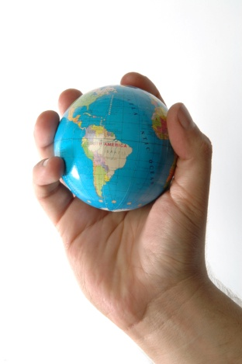
Implications and Application
The work of these children and this project have exciting implications for teaching; this is one example of an activity that fully engaged students academically, emotionally, and in a real-world context with meaningful learning outcomes. Through one picture, they were able to express knowledge of social studies, art, literacy, current affairs, and even, to some degree, human psychology. In the spirit of this UNICEF project, I have created an instructional plan that I could use with my second graders to accomplish some of these same goals in a different way. The details of this plan follow in the next sequence of slides.

Slide 15
Instructional Plan
This instructional plan is based on Google Maps. By using this, I am helping accomplish some technology curriculum goals as well as all the others previously mentioned. It is similar to something I have done in the past, but this takes it to the next level, further refining its effectiveness and strength. That is part of great teaching-getting better and improving methods each year!
Step 1: Students place a pinpoint on a shared class Google map showing where they were born.
Step 2: Students place pinpoints on the same map showing where their parents were born. (For situations where this is not possible, other arrangements can be made. For instance, perhaps a sibling or other relative’s birthplace can be marked).
Step 3: For each pinpoint they place, students must post information telling about it. This way, when other students click the pinpoint they can learn all about that specific location. Students can post information about people, culture, education, daily life, landforms, government, vegetation, animals, the economy, etc. To Find this information, students can research each place using various resources, such as the internet, texts, and even interviews of people who have lived there.

Slide 16
Instructional Plan Continued
Step 4: When all information has been researched and entered, students can freely explore the map, clicking pinpoints and reading the information about each birthplace. As they explore, they can write down questions they may want to look further into and then use resources to find answers.
Step 5: This shared map can be posted on our class wiki, so that students can access it from anywhere at any time. Students could even continue adding more pinpoints for other relatives as time progresses. With time, the map would have pinpoints all over the world, increasing students knowledge of diversity and global contexts.
The learning that would take place in this project is extremely rich. Students would be learning geography, history, heritage, research skills, technology, and so much more. Because it would be based on them, their motivation and interest would probably be very high.
To measure their learning, informal assessments could be conducted through conversations, reading wiki comment posts, and observing students work on and explore the map. Of course, there would be a continuous dialogue surrounding global knowledge, connections, and benefits of diversity.

